Slide 1
Customer Support Chat bot with ML
PIP2001 Capstone Project
Review-1
Batch Number:
Under the Supervision of,
Mr.Praveen Giridhar Pavaskar
Professor
School of Computer Science and Engineering
Presidency University
Roll Number | Student Name
20211CCS0029 | Fatima Noori
20211CCS0077 | Sony Priya
20211CCS0123 | G Sarayu
Name of the Program: BTech(Computer Science Engineering)
Name of the HoD: Dr. Anandaraj S P
Name of the Program Project Coordinator: Dr. Sharmasth Vali Y
Name of the School Project Coordinators: Dr. Sampath A K / Dr. Abdul Khadar A / Mr. Md Ziaur Rahman

Slide 2
Introduction
Chatbots are software programs created explicitly for textual or spoken conversation. These apps frequently act as virtual assistants or companions by trying to mimic human behavior. Although passing the Turing test has always been the goal, reaching this level of sophistication in 2023 will still be difficult.
Three main categories arise in chatbot development:
1. Rule-based chatbots
2. Retrieval-based chatbots
3. Autonomous and self-learning chatbots
Each kind, present and future, extends the variety of conversational agents on the market in 2023 by adding new features and

Slide 3
Literature Review
A chatbot, also known as a "chat robot," is a computer program that uses artificial intelligence (AI) and natural language processing (NLP) to simulate human conversation through text or voice interactions.
These automated agents are designed to understand and respond to user queries, providing information, assistance, or performing tasks within defined parameters.
ELIZA, developed by Joseph Weizenbaum at MIT in 1966, is an early chatbot that uses pattern-matching techniques to simulate a Rogerian psychotherapist, demonstrating meaningful interaction.
ALICE, developed by Dr. Richard Wallace in 1995, was a rule-based chatbot that gained popularity online. Smarter Child, created by Active Buddy in 2001, was one of the first chatbots to gain widespread popularity, providing information on various topics.

Slide 4
Literature Review
IBM's Watson in 2011 demonstrated the power of machine learning and natural language processing, winning Jeopardy! and demonstrating applications in healthcare and finance. Siri, introduced by Apple in 2011, introduced voice-activated personal assistants, demonstrating the potential for natural language understanding in mobile devices.
Facebook's Messenger Bots in 2016 marked a significant milestone in the widespread adoption of chatbots for commercial applications.
OpenAI's GPT-3, a breakthrough in natural language processing, offers features like live news, weather scores, and microphone services for searching. It uses voice recognition to simulate human conversations using NLP, acting as a virtual friend to help users find answers easily. The chatbot also provides microphone services for voice recording.

Slide 5
Existing method Drawback
* AI chatbots can potentially spread false or biased information due to their reliance on outdated, inaccurate, or irrelevant data from the vast internet pool. This can lead to misinformation.
*Lack of emotional intelligence: Even though AI chatbots respond to queries in a conversational manner, they lack the emotional intelligence, empathy, and morality of an actual human. They might answer in potentially insensitive or disturbing ways, that might impact users’ feelings.
*Limited creativity: AI chatbots are also known to fail at out-of-the-box thinking, scoring low on creativity and originality. They have a limited understanding of language and concepts and may provide answers that are irrelevant or incorrect.
*Risk of hacking: As AI advances, bad actors are increasingly using AI chatbots to carry out social engineering attacks. They can impersonate someone else’s writing style to make phishing attacks seem more realistic. At the same time, AI chatbots can create malicious scripts and malware and exploit vulnerabilities, leading to security incidents and data
exfiltration.
*Chatbots often struggle with complex issues, lacking creativity and problem-solving skills. They may offer generic or repetitive solutions, which may not adequately address the complexity of the problem.

Slide 6
Proposed Method
Our project is an exciting step forward in modernizing customer service chatbots. The standout feature is its "speak aloud" functionality, which allows users to engage through voice input, setting it apart from typical text-based chatbots. Powered by machine learning, the chatbot can handle spoken inquiries, text, and even convert images to text. With a user interface that includes voice input, image-to-text conversion, and a quick copy feature, it offers a streamlined, adaptable solution for customer engagement. This innovative approach aims to transform customer service by providing quick, organized, and efficient responses to users.

Slide 7
Objectives
It is the most common way of carrying out the proposed approach for the chatbot.
Implementation Steps:
1. User Engagement: The customer begins the interaction by typing a question or message into the text interface of the
chatbot or by speaking their inquiry out loud. The input can also be provided in the form of images with text.
2. Intent Recognition: Using a Naive Bayes technique, a machine learning engine trained on a dataset of customer service
encounters user questions, extracts key phrases to detect their purpose, and tags them into predefined groupings.

Slide 8
3. Response Generation: After determining the user's intent, the chatbot uses a fine-tuned Ollama model built on the Mistral
framework to create a natural and informative response that addresses the individual query and user demands.
4. Data Retrieval (Optional): The chatbot seamlessly interacts with a connected database if the generated response requires
specific information not immediately available within the model's knowledge base. Utilizing keywords and parameters
extracted from the user's query, it retrieves relevant data from the appropriate source, ensuring a comprehensive and
informative response.

Slide 9
5. Response Delivery: The chatbot seamlessly merges the generated response with any retrieved data. It presents it clearly
and concisely within the chat interface, ensuring a comprehensive and informative response that effectively addresses the
user's initial query.
6. Continuous Learning: The chatbot empowers users to share feedback through ratings, reports, or suggestions, which forms
the foundation for continuous improvement. Analyzed feedback fuels refining the ML model's training data, adjusting response
generation parameters, and optimizing data retrieval processes, ultimately enhancing the chatbot's effectiveness and ensuring
user satisfaction.

Slide 10
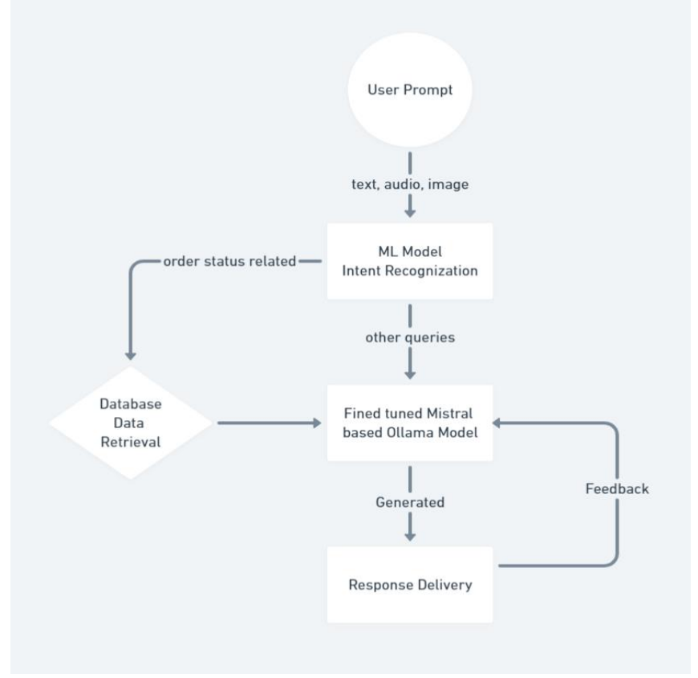
System Design & Implementation

Slide 11
Methodology/Modules
Machine Learning:-
Machine learning is categorized as follows:
Supervised Learning
Unsupervised Learning
Reinforcement Learning
Large Language Model (LLM)

Slide 12
Hardware/software components
Data Requirements
Natural Language Processing (NLP)
Language Support
Voice and Speech Processing
Machine Learning Models
User Interaction
Performance Metrics
Security and Privacy
Integration Capabilities
Scalability and Maintenance
Feedback and Learning

Slide 13
Timeline of Project

Slide 14
Expected Outcomes
Our machine learning-powered chatbot for customer service enhances customer relationships by facilitating conversations through spoken queries. Combining Language Model methods with ML-based models, it provides a precise and flexible system that understands various user inputs.
The user interface is improved with input methods like speech and image, and a quick copy capability. An all-auth login mechanism ensures security and personalized interactions.
Future upgrades may focus on improving ML models and incorporating more features and languages.
Our chatbot offers a superior user experience through live events, making it stand out. Future enhancements include a Google-like interface for a centralized access to all facilities, further enhancing the platform's user experience.
Chatbots are revolutionizing communication and customer support, with emerging technologies and AI enhancing their effectiveness.A chatbot, allows adolescent users to openly discuss their mental health issues, a crucial concern for society.
The project aims to analyze emotional disturbances faced by teenagers and their causes, fostering happier generations. The use of technology in implementing a conversational chatbot can further enhance the user experience. Overall, chatbots are proving to be a valuable tool in promoting mental health.

Slide 15
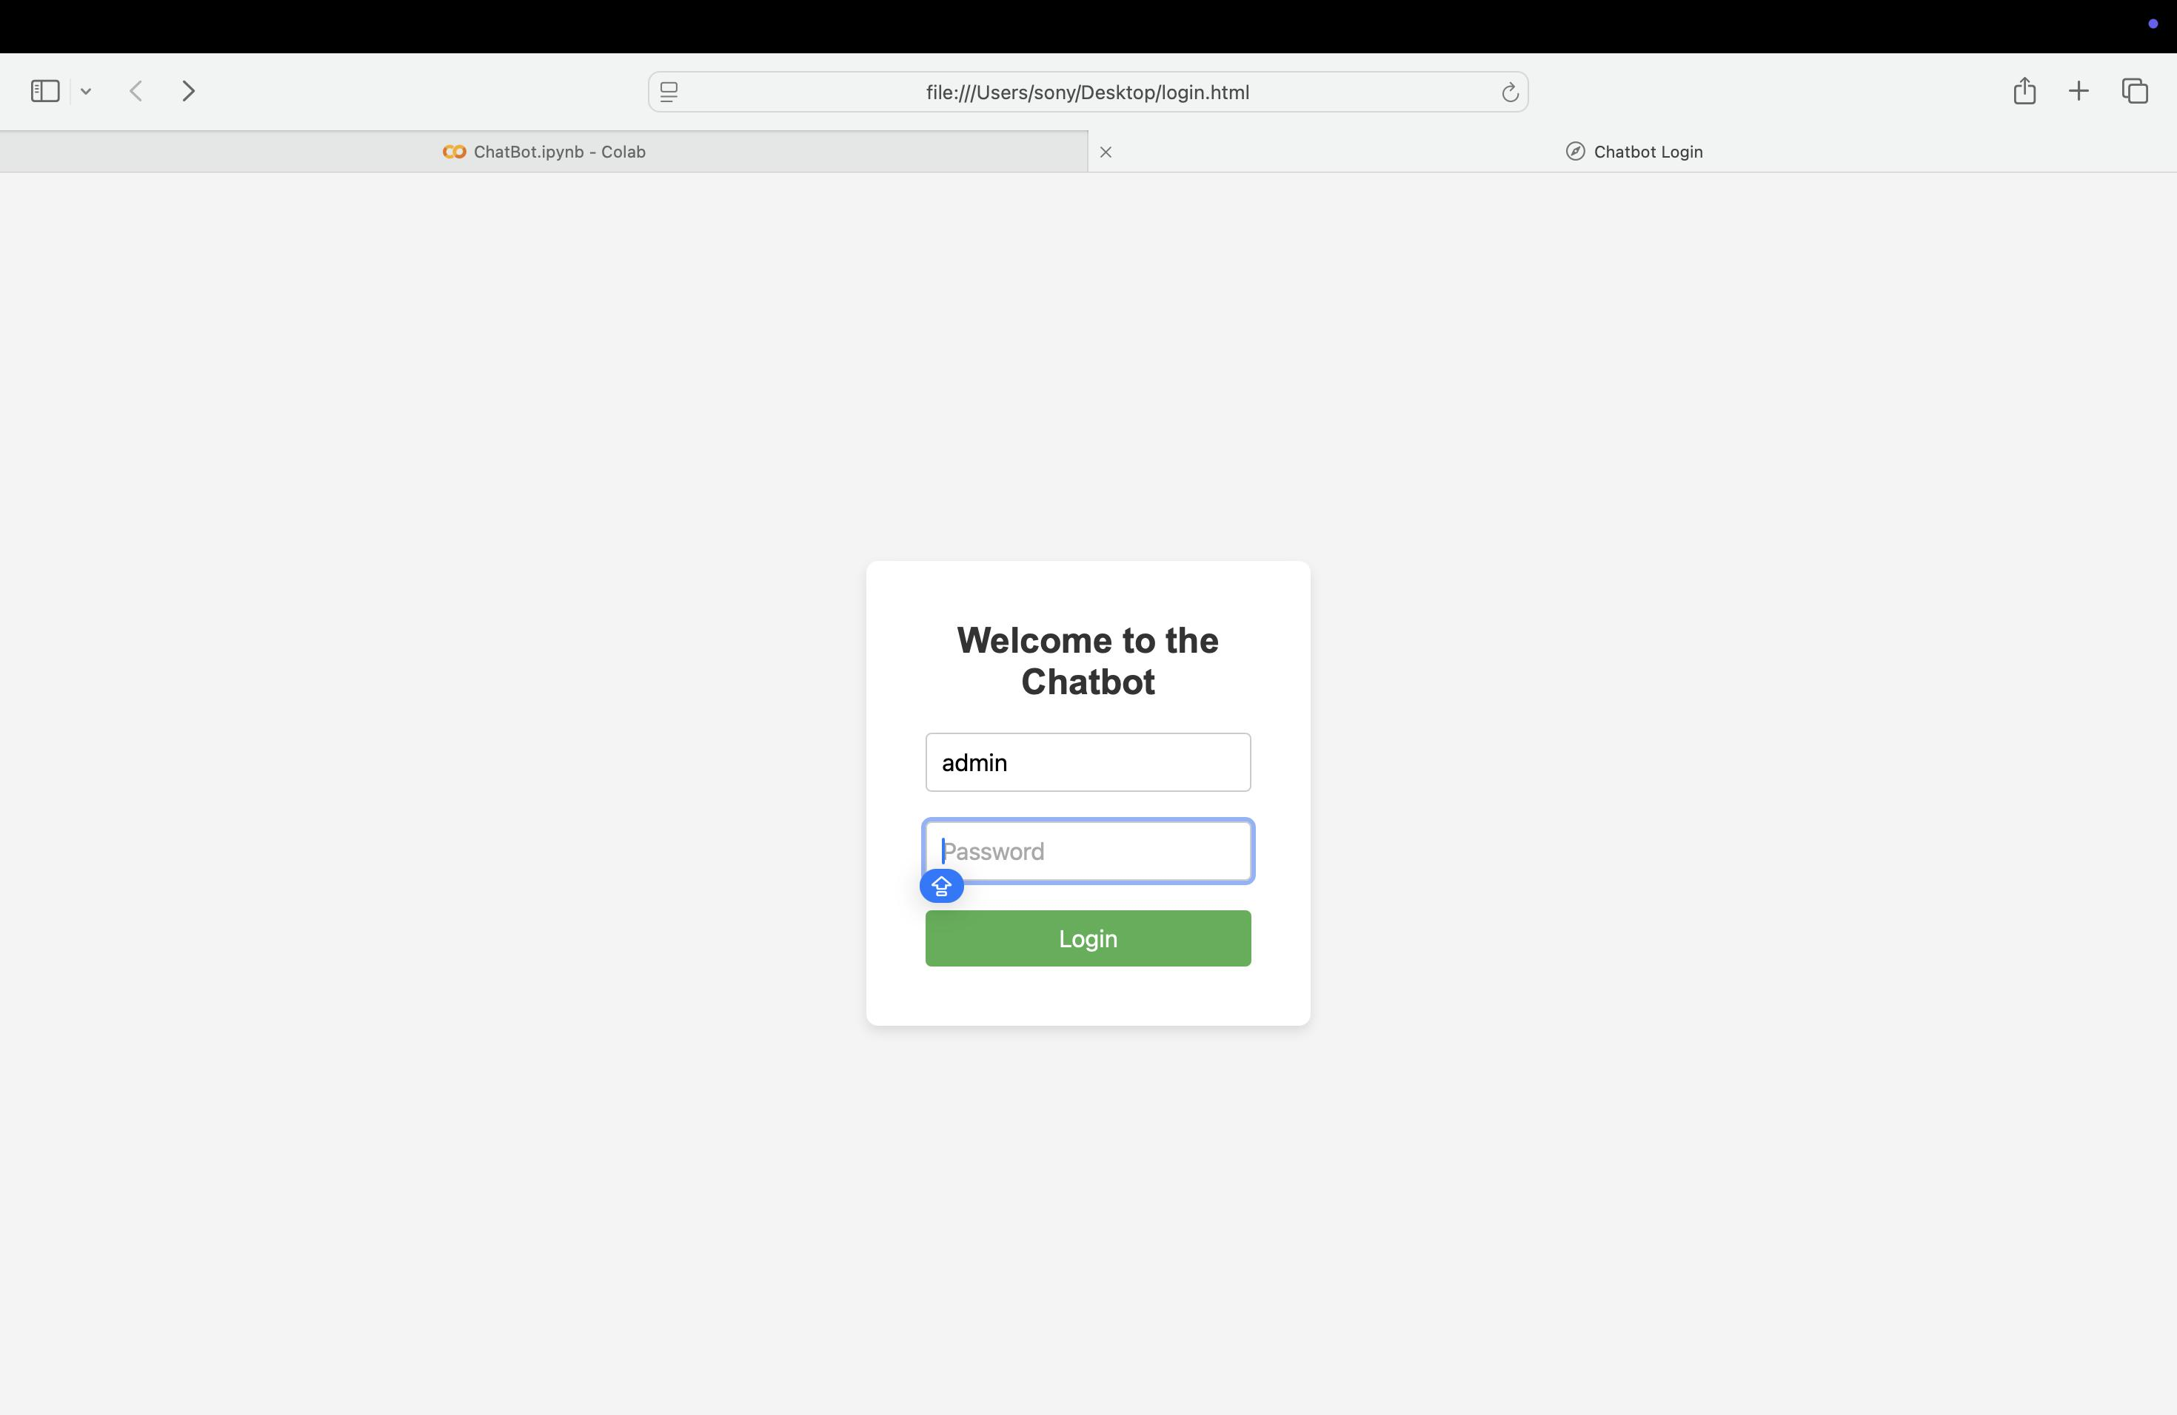
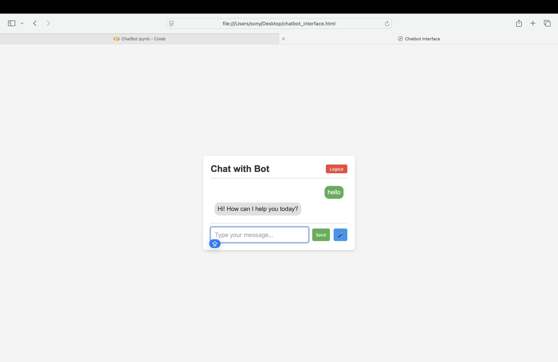

Slide 16
Conclusion
In conclusion, our machine learning (ML)-powered chatbot offers a transformative approach to enhancing customer relationships. What sets this chatbot apart is its unique "speak aloud" feature, enabling users to interact via spoken queries. By combining Language Model (LM) techniques with ML-based models, the system ensures both precision and adaptability in understanding various user inputs. The user interface is further enhanced with multiple input options, including voice, image-to-text conversion, and a quick copy feature, providing a comprehensive and efficient solution. Security is prioritized through an all-auth login mechanism, ensuring personalized and secure interactions. Future updates will focus on improving the precision of the ML models, expanding functionality, and adding support for additional languages. This project represents a new era for customer service, leveraging advanced technology to revolutionize the user experience.

Slide 17
Github Link
Github Link

Slide 18
References
1. (PDF) Customer Support Chatbot Using Machine Learning
https://www.researchgate.net/publication/343980800_Customer_Support_Chatbot_Using_Machine_Learning
2.Flask Basic tutorial
https://www.tutorialspoint.com/flask/index.html
3.CUSTOMER SUPPORT CHATBOT WITH MACHINE ...
International Research Journal of Engineering and Technology (IRJET)
https://www.irjet.net

Slide 19
Publication Details

Slide 20
Achievements (if any)
Intelligent Automation & Personalization:-Zendesk's Answer Bot uses ML to analyze customer queries and suggest relevant help center articles, offering personalized answers based on past behavior.
Sentiment Analysis & Emotional Intelligence:-LivePerson integrates sentiment analysis to detect customer emotions, adjusting the chatbot’s tone or escalating the conversation to a human agent when necessary.
Automated Ticket Routing and Issue Resolution:-Freshdesk uses ML models to route tickets more efficiently and automatically suggest solutions to agents, speeding up the resolution process.

Slide 21
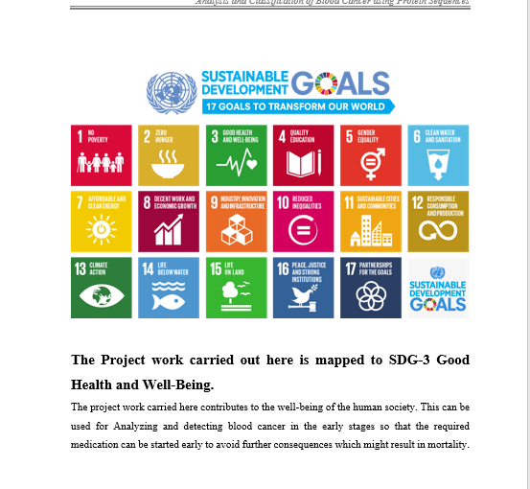
Project work mapping with SDG

Slide 22
Thank You

